Slide 1

Turtle Snake Flashlight
A teamwork project by JLU&UIC program students:
Jing Li, Chengzhang Li, Bolin Dai and Yinan Fu
Outer case
Reporter: Yinan Fu

Slide 2
Road map
Project Requirement
Project Vision
Product Presentation
Hardware Design
Outer case Design

Slide 3
Road map
Project Requirement
Project Vision
Product Presentation
Hardware Design
Outer case Design

Slide 4
Project Requirement
Topic: Flashlight with one extra function
Limited hardware resources: Micro-controller, LED
(MSP430 from TI)
Resistance, Transistor
Must have a 3D-printed outer case

Slide 5
Road map
Project Requirement
Project Vision
Product Presentation
Hardware Design
Outer case Design

Slide 6
Our Vision: Make your flashlight your new snake game player!

Slide 7
Road map
Project Requirement
Project Vision
Product Presentation
Hardware Design
Outer case Design

Slide 8
Road map
Project Requirement
Project Vision
Product Presentation
Hardware Design
Outer case Design

Slide 9
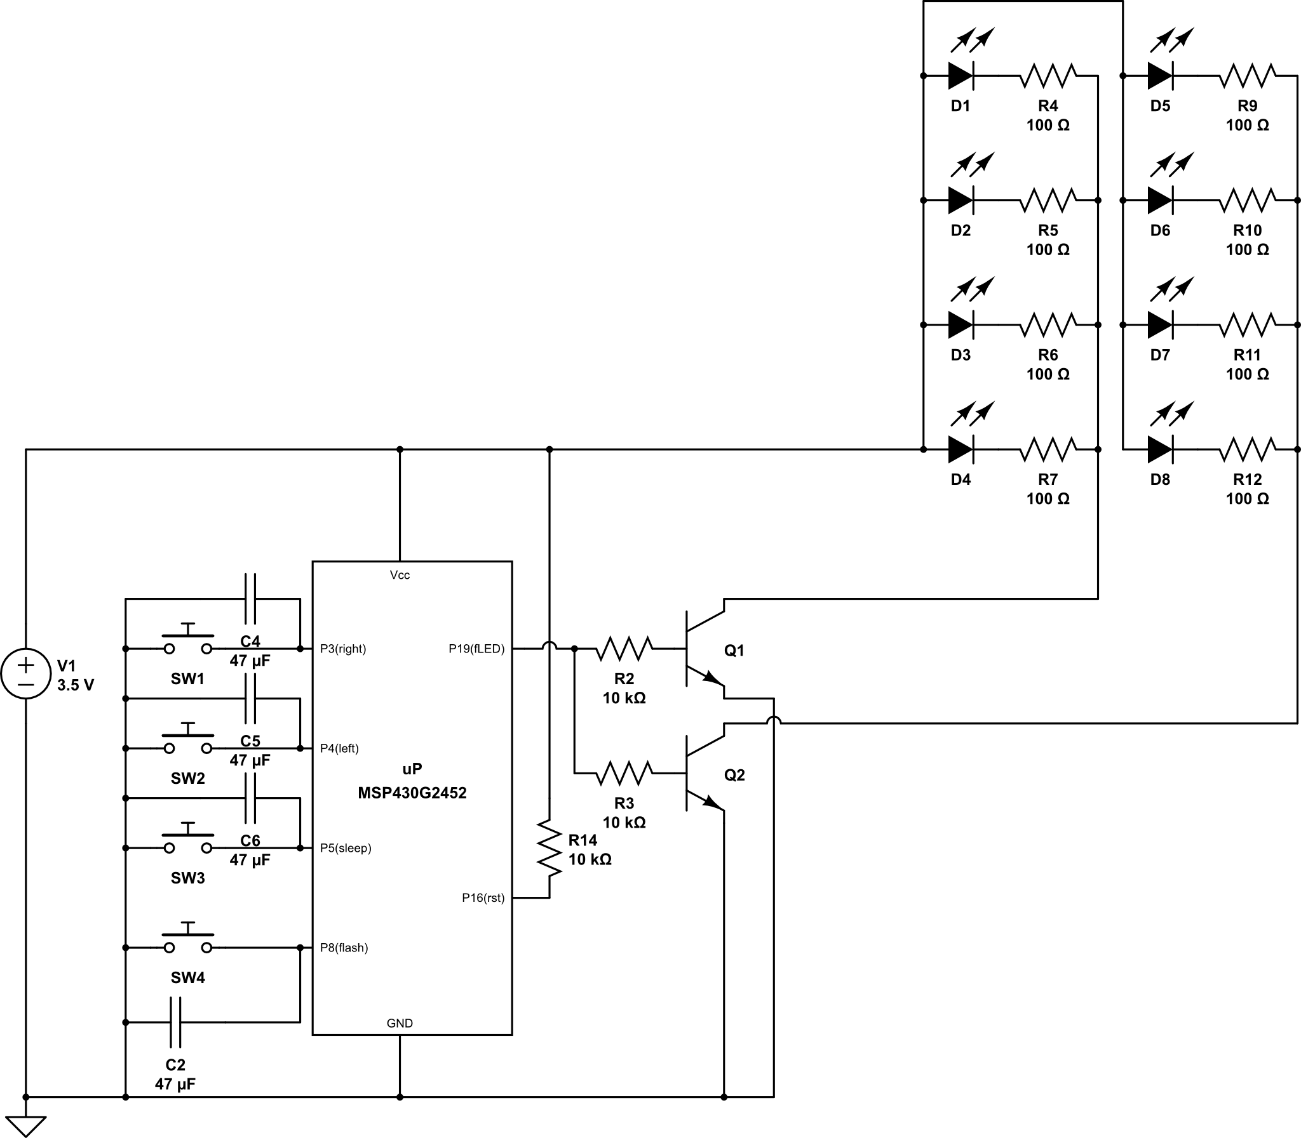
Main board circuit

Slide 10
This micro-controller is powered by 3.5 voltage
given by 2 AA batteries.

Slide 11
Four switches are parallel connected with capacitance
eliminating button bounce and giving a steady press feeling.

Slide 12
8 flashlight LEDs are directly driven by the battery.
One I/O pin is used to control the connectivity of these LEDs.

Slide 13
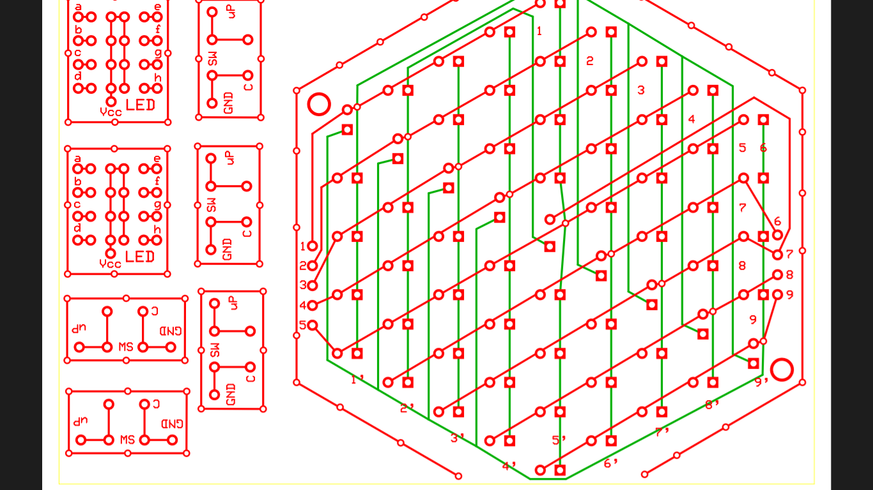
We use 9 I/O pins to control 61 LEDs
Main LED matrix

Slide 14
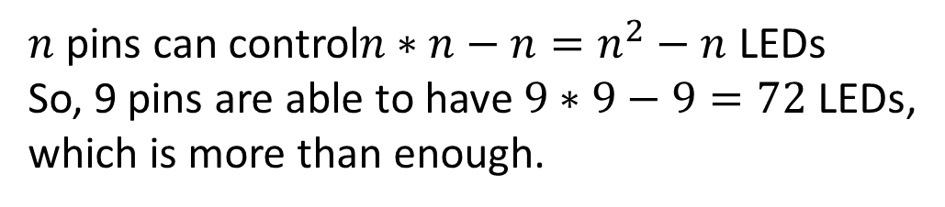

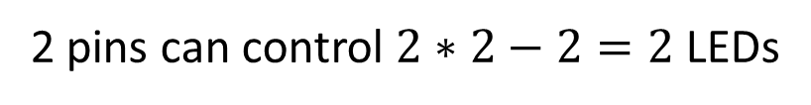
Charlieplexing
P1
2 pins can control $2∗2−2=2$ LEDs
P2
P1
P2
3 pins can control $3∗3−3=6$ LEDs
P3
$n$ pins can control$n∗n−n=n^{2}−n$ LEDs
So, 9 pins are able to have $9∗9−9=72$ LEDs,
which is more than enough.

Slide 15
Road map
Project Requirement
Project Vision
Product Presentation
Hardware Design
Outer case Design

Slide 16
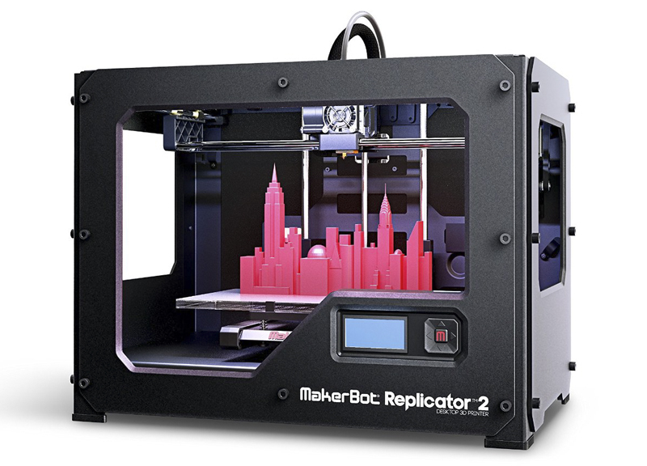
3D Printer

Slide 17
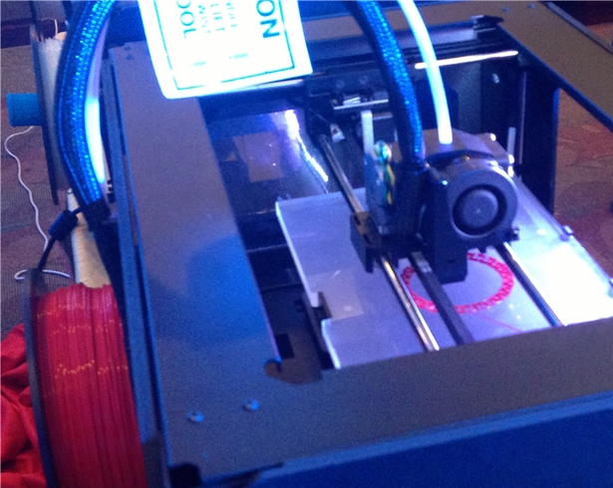
Printing Scene
extruder
filament
Build plane

Slide 18
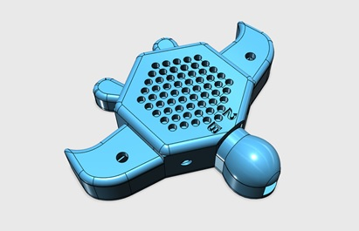
Perspective diagram

Slide 19
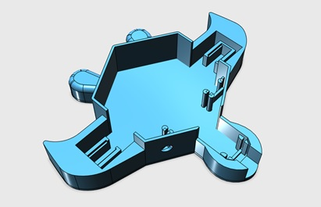
Perspective diagram

Slide 20
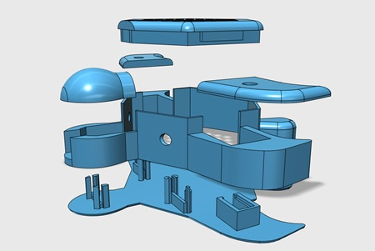
Assembling diagram

Slide 21
Thank You!

